Slide 1
INTERNATIONAL ECONOMIS
Course code- ECONA306
Class- BA 3rd year
Discipline Specific Elective
Session -2022-23
Gopal Bhardwaj
Assistant Professor
Dept. of Economics

Slide 2
Introduction
Will explore three realms of the modern world economy
  International trade
  International production
  International finance

Slide 3
International Trade
The exchange of both goods (merchandise) and services among the countries of the world.
Goods: tangible and storable (something you can drop on your toe).
Services: intangible and non-storable (something you cannot drop on your toe).
Trade in services accounts for approximately one fifth of global trade.
The two are often intertwined.

Slide 4
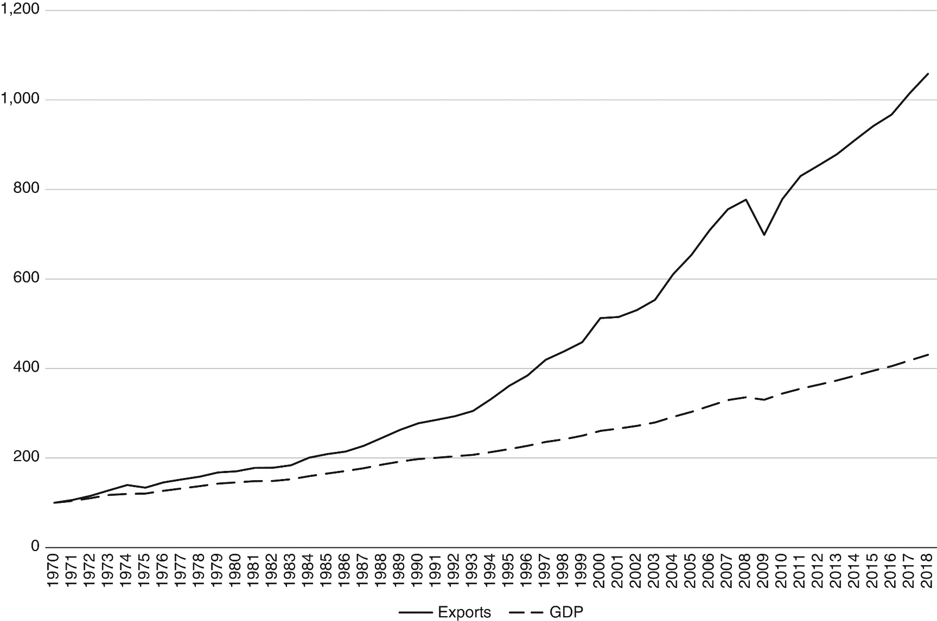
Figure 1.1 Gross Domestic Product and Exports in the World Economy, 1970 to 2018 (1970=100). Source: World Bank, World Development Indicators

Slide 5
Expansion of international trade
There are many reasons for the expansion of world trade:
  Transportation: the container shipping revolution
  Technology: information and communication technology (ICT)
  Tariffs: trade liberalization
  Entry of China: market reforms beginning in the late 1970s; joining the World Trade Organization (WTO) in 2001

Slide 6
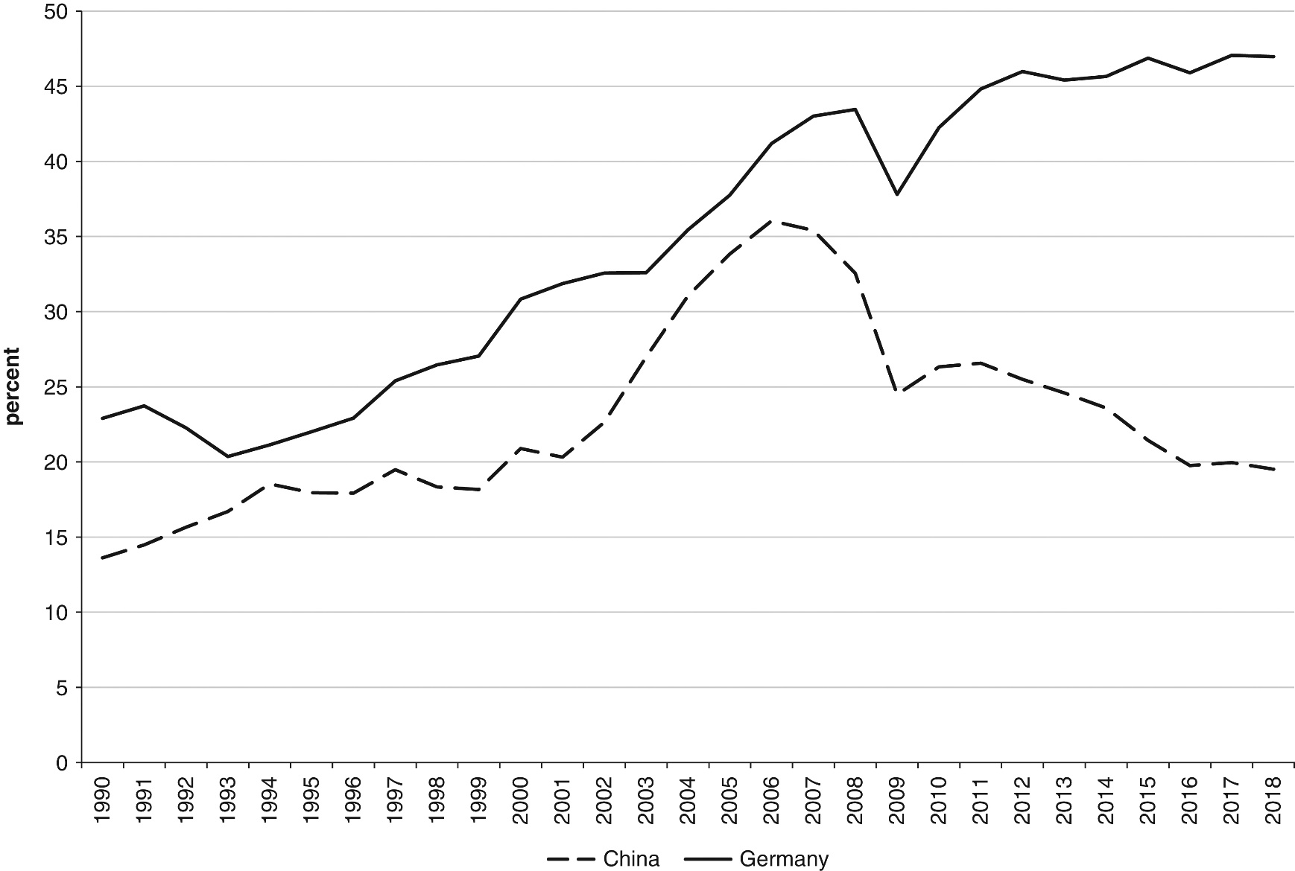
Figure 1.2 Exports as a percentage of GDP, China and Germany, 1990 to 2018. Source: World Bank, World Development Indicators
China’s exports as a percentage of GDP are substantially lower than those of Germany and
have been decreasing since 2006.

Slide 7
International Trade
Part I of the book will explore the major factors underlying international trade. Key concepts include:
  Comparative advantage
  World Trade Organization
  Preferential trade agreements
A full understanding of the factors underlying international trade will also require an understanding of international production, which will be taken up in Part II.

Slide 8
International Production
Production of a product in multiple countries
Can take place through
  Non-equity contracting
    Foreign outsourcing, licensing and franchising
  Foreign direct investment (FDI) undertaken by multinational enterprises (MNEs)
    Involves firms based in one country owning at least a 10 percent of firms producing in another country

Slide 9
International Production
MNEs are particularly important actors in the world economy.
  MNEs account for approximately one fourth of world gross domestic product (GDP) or aggregate output.
  The sales of foreign affiliates of MNEs now exceed the volume of world trade.
  MNEs are involved in approximately three fourths of all world trade.
  Approximately one third of world trade takes place within MNEs.
  MNEs account for approximately three fourths of worldwide civilian research and development.

Slide 10
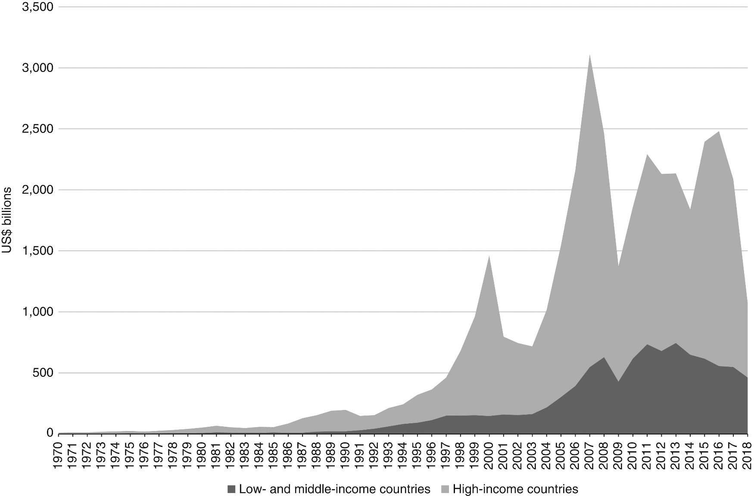
Figure 1.3 Nominal FDI Inflows to Low, Middle and High Income Countries, 1970 to 2018. Source: World Bank, World Development Indicators.

Slide 11
International Production
Both contracting relationships and FDI are configured between countries in global value chains (GVCs).
GVCs: systems of value chains linked together in buyer-supplier or ownership relationships across countries
  ICT-enabled GVCs are the defining feature of modern globalization (Baldwin 2016)
Migration: relevant to international production
  3 to 4 percent of the world’s population has migrated

Slide 12
International Finance
Refers to the exchange of assets among countries
  Individuals and firms around the world conduct international transactions in
    Currencies
    Equities
    Government bonds
    Corporate bonds (commercial paper)
    Real estate
Plays increasingly important role in the world economy: foreign exchange transactions are much larger than trade transactions

Slide 13
International Finance
Capital flows of global finance: can be destabilizing (balance of payments crises, financial crises)
A process known as capital flight: investors selling a country’s assets and reallocating their portfolios into other countries’ assets
The Global Financial Crisis beginning in 2008, with roots in the US housing market. Its most severe effects were felt in Europe.
International finance is a realm of increasing importance in the modern world economy.

Slide 14
Impacts on International Development
It is hoped that the processes of international trade, production and finance will contribute to international development, namely improved levels of welfare and standards of living throughout the world.
Two major issues usually arise
  how we conceptualize levels of welfare or standards of living.
  how the processes of international trade, international production, and international finance support or undermine international development.
  Neither of these issues has been fully settled.

Slide 15
Impacts on International Development
Different ways of defining development:
  Mainstream economics: gross domestic product per capita (the average value of production produced by a citizen of a country)
    Limitation: GDP is not a measure of welfare
  Main alternative: the “capabilities” approach, which assesses development outcomes in terms of a range of human capabilities—things people can actually achieve
    The capabilities approach is often assessed using the Human Development Index (HDI), developed by the UNDP
      Per capita income
      Average life expectancy
      Average levels of education
Development outcomes vary widely across countries

